Slide 1

Simple Expense Tracker Application
Java Backend + HTML/CSS/JavaScript Frontend
BY ALEKYA SAMMANGI JANUARY 2025

Slide 2
Approach & Design
Three-Tier Architecture:
Frontend Layer
HTML/CSS/JavaScript
Key Design Principles:
✓ Separation of Concerns
✓ Pure Java - No Frameworks
✓ RESTful API Design
✓ File-Based Persistence
Business Layer
Java Classes
Data Layer
Json file Storage

Slide 3
Key Backend Files
File Name | Purpose |  | Key Features
Expense.java | Data Model |  | POJO with getters/setters, custom toJson()
ExpenseManager.java | Business Logic |  | Add, calculate, analyze expenses
FileStorage.java | Persistence |  | Custom JSON parser, file I/O
ExpenseServer.java | HTTP Server |  | REST API, request handling

Slide 4
Key Frontend Files
Index.html | App.js | Style.css
Structure & Layout Add expense form Statistics cards Chart containers Expense table | Dynamic Functionality Fetch API calls DOM manipulation Chart.js rendering Real-time updates | Modern Styling Gradient backgrounds Responsive CSS Grid Card-based design Mobile-friendly layout

Slide 5
Project Structure
expense-tracker/
├── src/
│ └── main/
│ └── java/
│ └── com/
│ └── expensetracker/
│ ├── model/
│ └── Expense.java
│ ├── service/
│ ├── ExpenseManager.java
│ └── FileStorage.java
│ └── server/
│ └── ExpenseServer.java
├── frontend/
│ ├── index.html
│ ├── style.css
│ └── app.js
├── data/
│ └── expenses.json (auto-generated)
├── test/
│ └── seed-data.json
└── README.md

Slide 6
How to Run - Compilation & Execution
Compile
Compile Java Code
# Create output directory
mkdir -p bin
# Compile Java files
javac -d bin src/main/java/com/expensetracker/model/*.java
javac -d bin -cp bin src/main/java/com/expensetracker/service/*.java
javac -d bin -cp bin src/main/java/com/expensetracker/server/*.java
Run
Run the Server
java -cp bin com.expensetracker.server.ExpenseServer
Expected Output:
Server started on port 8080
Open http://localhost:8080 in your browser
Access
Access Application
Open browser
Navigate to: http://localhost:8080
Start using the application!

Slide 7
Testing
Manual Test Scenarios:
Add Expense Test
Select category: Food
Enter amount: $50.00
Select today's date
Expected: Appears in table, total updates
Statistics Test
Add 3 expenses (different categories)
Expected: Highest/lowest correct
Charts Test
View trend & category charts
Expected: Interactive, accurate
Delete Test
Click delete button
Expected: Removed, stats recalculate
Persistence Test
Restart server
Expected: All data still present

Slide 8
Verification
Backend Verification: ✅ Server starts without errors ✅ Port 8080 accessible ✅ All 4 API endpoints respond ✅ JSON file created automatically ✅ Data persists after restart
Frontend Verification: ✅ Page loads completely ✅ Forms validate input ✅ Charts render correctly ✅ API calls succeed ✅ Delete buttons work ✅ Mobile responsive

Slide 9
Test data and Seed Data
The test/seed-data.json file contains 12 sample expenses:
Total: $965.00 Date Range: January 1-8, 2025 Highest: Bills ($215.00) Lowest: Transport ($55.00
Category | Count | Total
Food | 3 | $125.00
Transport | 2 | $55.00
Entertainment | 2 | $135.00
Bills | 2 | $215.00
Shopping | 1 | $200.00
Healthcare | 1 | $85.00
Education | 1 | $150.00

Slide 10
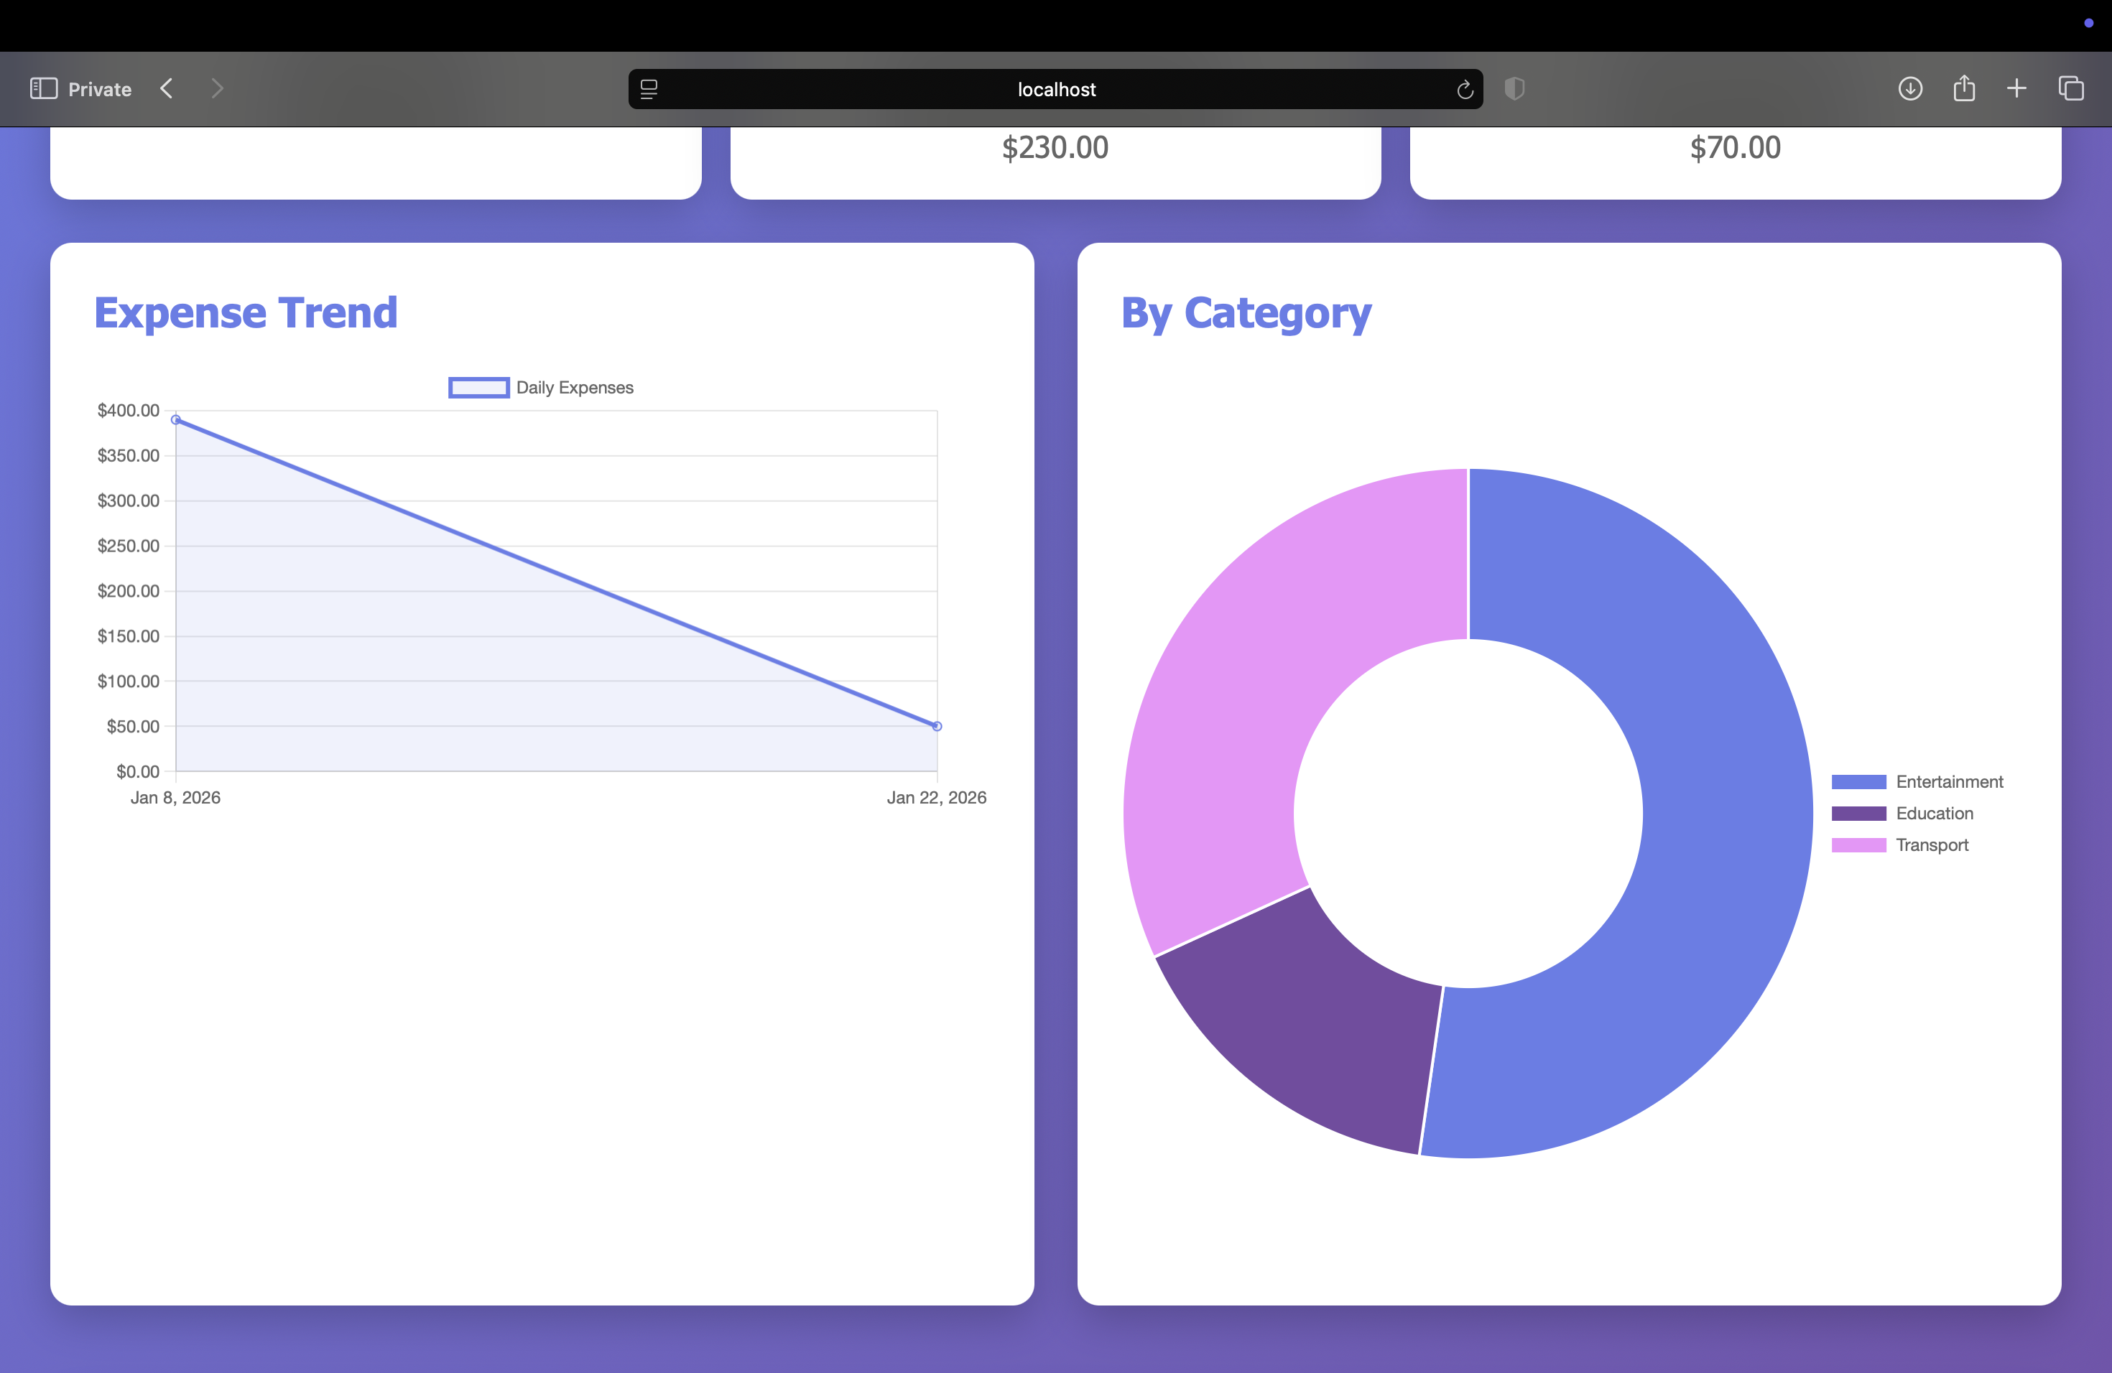
Expenses.json [ {"id":1,"category":"Transport","amount":50.00,"date":"2026-01-22","description":"bus"}, {"id":3,"category":"Entertainment","amount":60.00,"date":"2026-01-08","description":""}, {"id":4,"category":"Education","amount":70.00,"date":"2026-01-08","description":""}, {"id":5,"category":"Transport","amount":90.00,"date":"2026-01-08","description":""}, {"id":6,"category":"Entertainment","amount":80.00,"date":"2026-01-08","description":""}, {"id":7,"category":"Entertainment","amount":90.00,"date":"2026-01-08","description":""} ]
Categories: Food, Transport, Entertainment, Bills, Shopping, Healthcare, Education Total: $965.00 Date Range: Jan 1-8, 2025
How to Load:
bash
cp test/seed-data.json data/expenses.json
# Then restart server

Slide 11
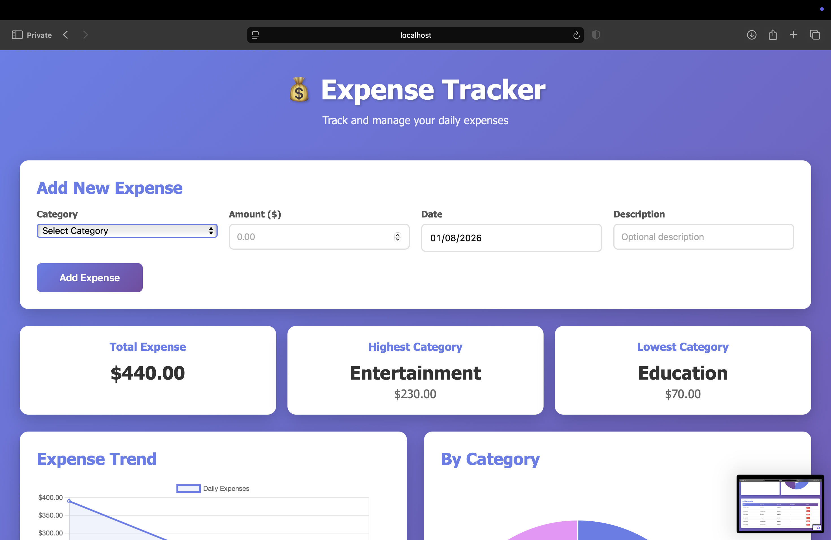
Key Features
1. Add Expense Form with dropdown, amount, date
2. Real-time Stats Cards showing Total, Highest, Lowest
3. Visual Analytics Line chart (trend) + Doughnut chart (category)
4. Expense Management Table with delete buttons

Slide 12
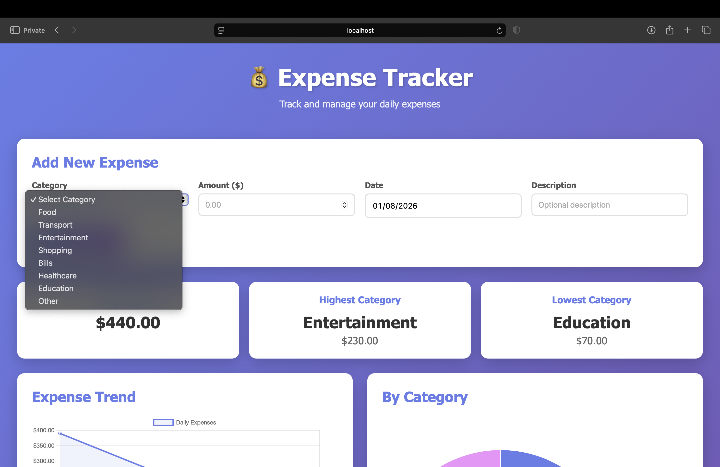
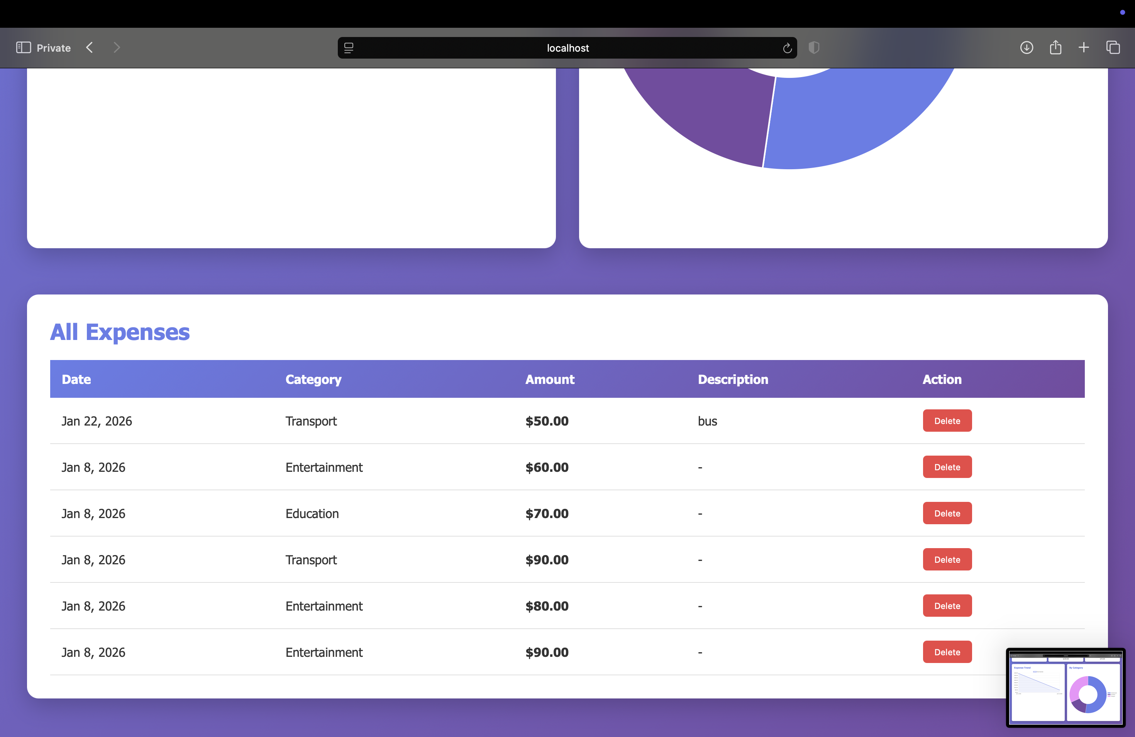
OUTPUT

Slide 13
GITHUB
https://github.com/Alekya0508/Expense-tracker-application.git

Slide 14
Future Improvements
Phase 1 (Short-term)
Edit expense functionality
Date range filtering
Search functionality
Export to CSV
Phase 2 (Medium-term)
User authentication
Budget planning
Spending alerts

Slide 15
Summary
✅ Fully Functional Application All requirements met
✅ Clean Architecture Three-tier design, separation of concerns
✅ Production Ready Error handling, validation, persistence
✅ Well Documented README, comments, presentation
✅ Easy to Run Compile, run, access

Slide 16
THANK YOU

